Slide 1
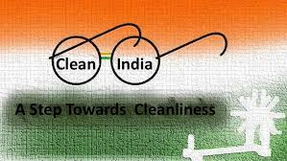
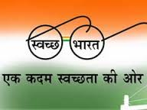
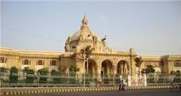
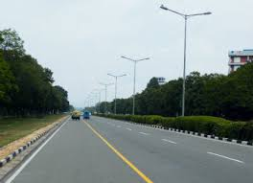
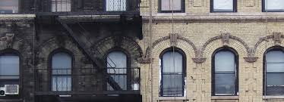


Clean India

Slide 2

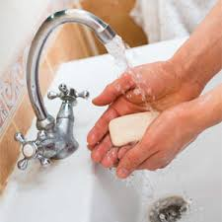

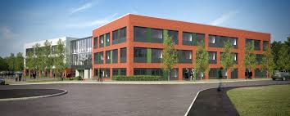
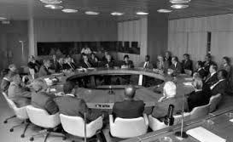
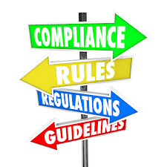
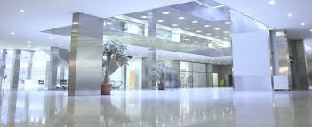
Index
Habits of cleanliness can be inculcated in human minds.
1
2
Establishment of “ Cleaning Academy for Cleaning - Knowledge Park
3
Procurement of right equipment
4
Setting systems , processes and regulations for cleaning.
Building Future – Clean India
5

Slide 3
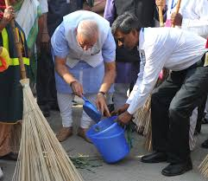
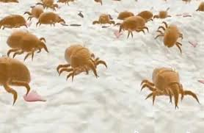
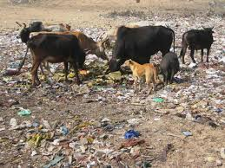
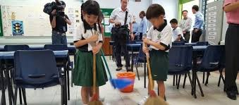
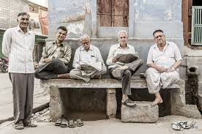
Cleaning Habits can be inculcated through education.
1
Our Mission – Cleanliness & Hygiene
2
Healthy Living
3
Education on Cleaning for all age Groups

Slide 4
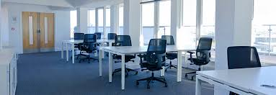
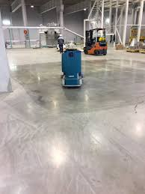
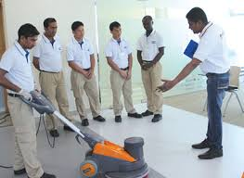
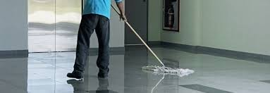
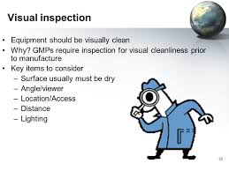
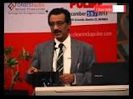
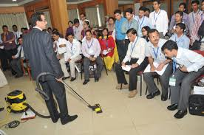

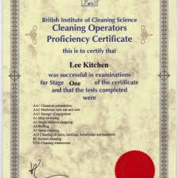
Establishment of Academy for Cleaning Science
Udgam Knowledge Park
Education and Trainings on effective cleaning processes.
Train the Trainer Modules
Skill Development and Time / Cost saving
Certified Courses “ Cleaning Science “
Ugdam Knowledge Park

Slide 5
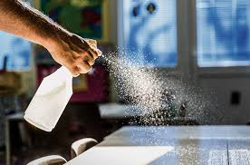
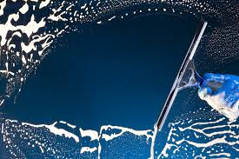
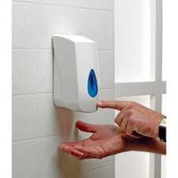
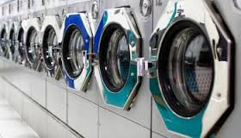
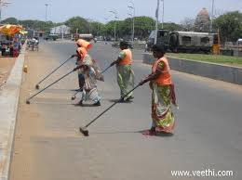
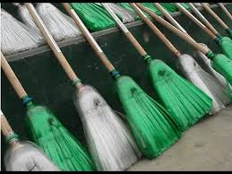
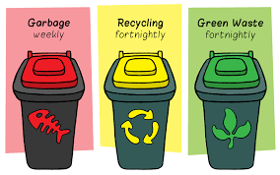
Cleaning Academy : To Educate on effective cleaning Methods
Using right tool / broom / equipment
Time and Motion Study
Effective Performance and Quality checks.
Waste Management

Slide 6
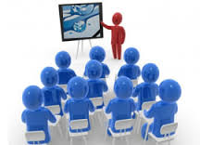
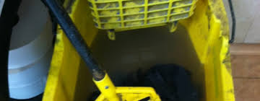
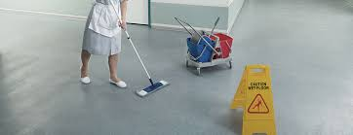
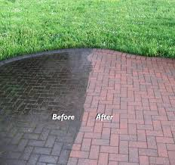
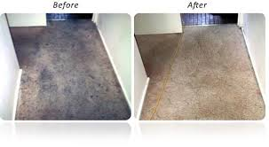
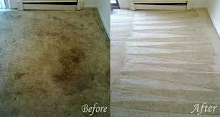
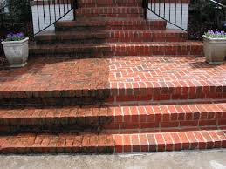
Cleaning Academy To Educate on effective cleaning Methods
Train cleaning responsible personnel for them to impart further trainings at site.
Identification of right and wrong
Hands on trainings with quality checks

Slide 7
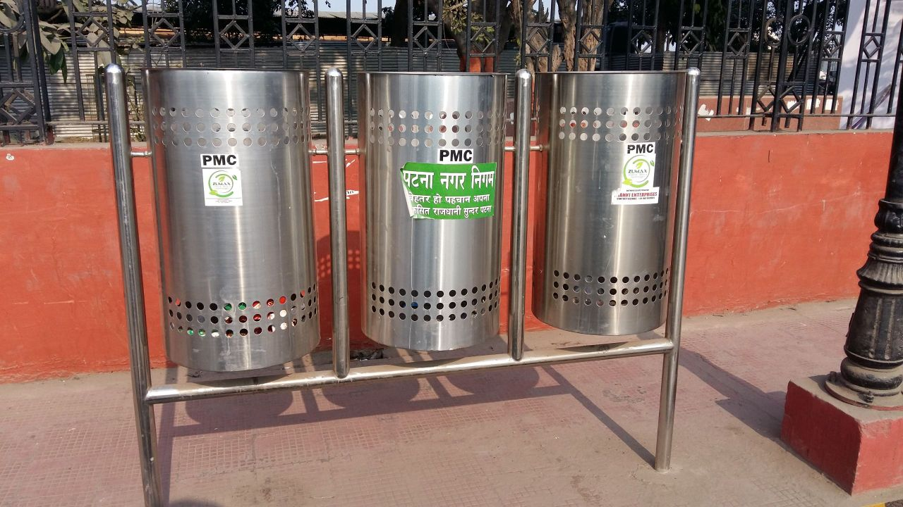
Waste Management
Waste segregation process
Collection & Disposal
Composting

Slide 8
Toilets
Inculcate right habits

Slide 9

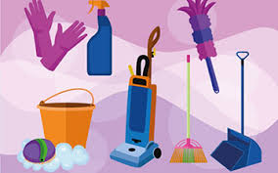
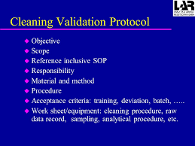
Cleaning Academy : To Educate on effective cleaning Methods
Develop unskilled workers to skilled workers.
“ Safai Karamchari to Operators”
Savings on Cost
Develop Future Trainers

Slide 10
Cleaning Academy : Courses with Certification.
Modules on cleaning tasks
To make “Cleaning” and Waste Management a curriculum”
Development of cleanliness habits
Certification
Future Employment “ Cleaning Specialists “
Specialized Knowledge

Slide 11
Procure of Right Equipment at RIGHT COST
Cost Savings
Formulating right tender specifications to ensure right equipment is procured
To educate the procurement officials on what is the right equipment at the right cost
Today procurements are made with less knowledge hence sub-standard / not so useful equipment are purchased

Slide 12
Setting standards - High Performance - Cost Effective.
  Drafting Service Level Agreements
  Preparing Check-lists
Compliance of Processes
Check Lists
Cost Analysis
Accountability
  Evaluation of cost Vs Performance
  Identifying performers and Non-performers.

Slide 13
Building up for the future – Role model India
Setting of systems and processes
      Educate on right
      processes
Inculcate feeling of cleanliness
Cost Savings with effective results

Slide 14
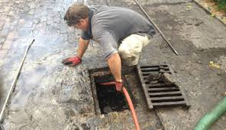
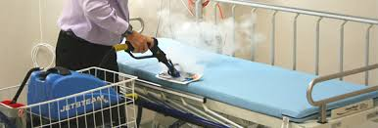
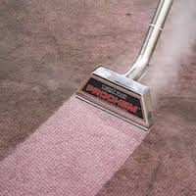
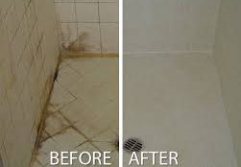
Areas of prime Importance
Schools
Hospitals
Roads
Buildings
Toilets
Transport

Slide 15

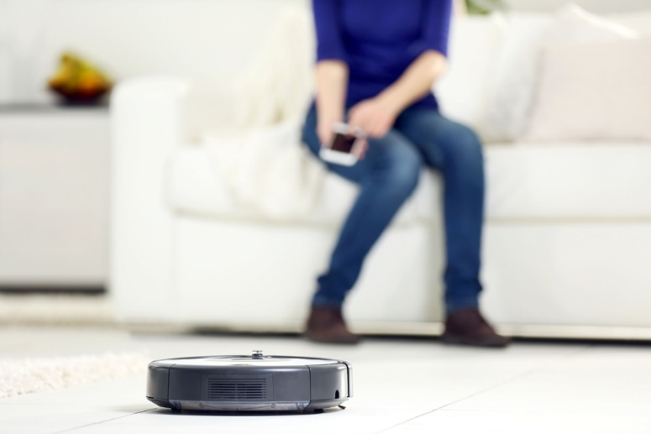
Modern ways of cleaning – Not Far to adopt.
GPS Enabled Machines and Robotic Machines
Future of Cleaning
Robotic Cleaning Machines

Slide 16
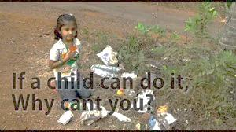

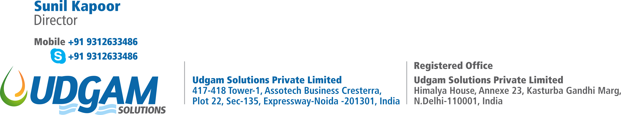
One More step towards Cleaning
“Cleanliness is something we all desire… even when we're busy doing other things, we subconsciously look out for cleanliness... it is a natural instinct for us to be clean,
" But a handful of leaders cannot realise the dreams of a Clean India, it needs the participation of 125 crore Indians. - Narendra Modi

